Slide 1
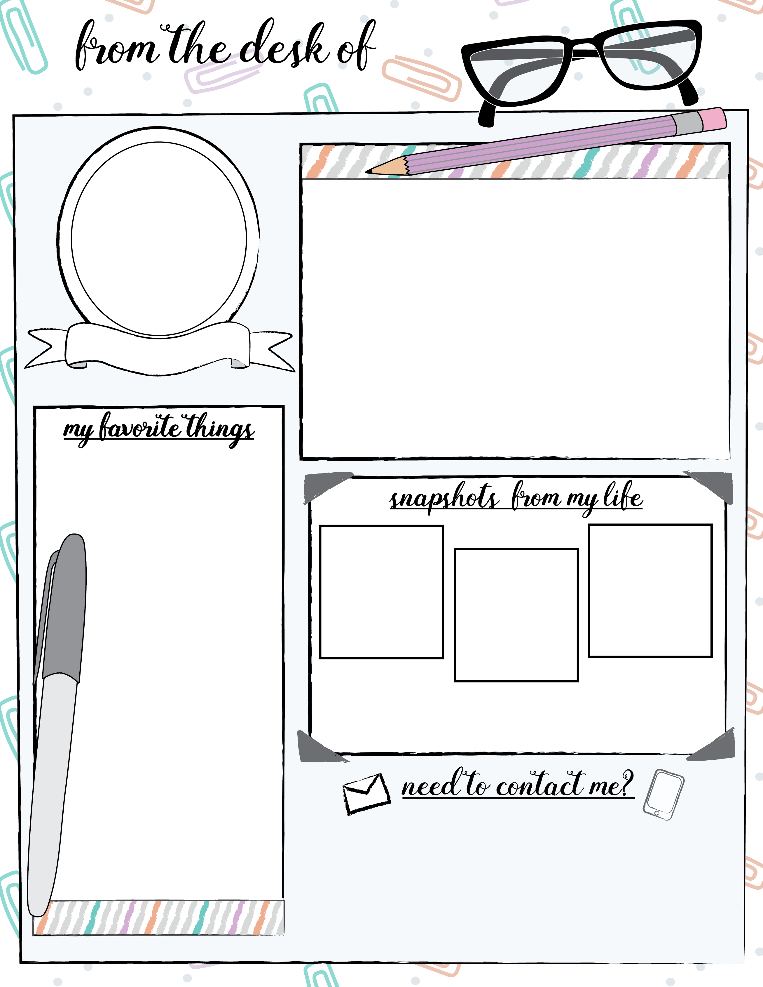
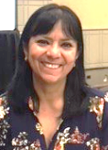
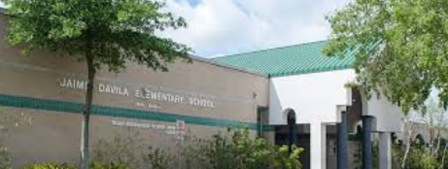
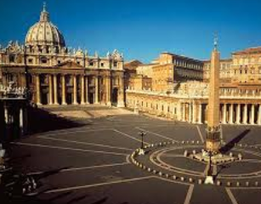
Your New Teacher
Hello!!
My name is Irma Orozco. I have been teaching for 27 years in this School, Jaime Dávila Elementary.
I am from Mexico; I finished my teacher Degree there. However, I got my Teacher certification here, in Houston, Texas through HISD and University of Saint Thomas.
Teaching is my passion. Helping a student feel successful is my goal.
Irma Orozco
3rd Grade Bil.
Color: Royal blue, red and yellow.
Hobbies: Traveling and
watch movies.
Place to Travel: All over the world!
Food: Mexican of course.
Candy: Chocolate, coconut… any candy!
Subject: Reading, Language arts and math.
Love to teach!
Got married in 2007!
Visiting the Vatican.
Phone: (713) 924-1851
Send me messages through Dojo!
Email:
iorozco@houstonisd.org
We will have an amazing year!

